Slide 1




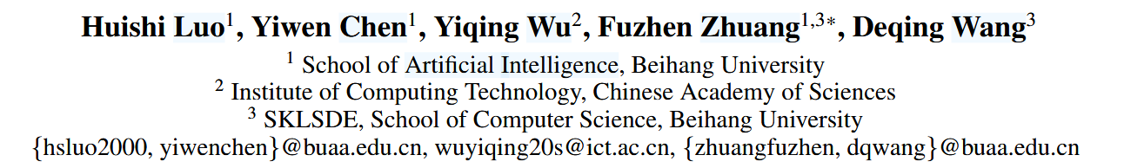





ATAI
Advanced Technique of Artificial Intelligence
ATAI
ChongqingUniversity _{AdvancedTechniqueof}
of Technology Artificial Intelligence
Chongqing University of
Technology
Chongqing University ^{ATAI}
_{of Technology} Advanced Techniqueof
Artificial Intelligence
Chongqing University of Technology
Chongqing University of Technology
One for Dozens: Adaptive REcommendation for All Domains with Counterfactual Augmentation
https://github.com/Chrissie-Law/AREAD-MultiDomain-Recommendation
——AAAI_2025
Reported by Jingbo Liu
1

Slide 2
ATAI
Advanced Technique of Artificial Intelligence
ATAI
ChongqingUniversity _{AdvancedTechniqueof}
of Technology Artificial Intelligence
Chongqing University of
Technology
Chongqing University ^{ATAI}
_{of Technology} Advanced Techniqueof
Artificial Intelligence
Chongqing University of Technology
Chongqing University of Technology
Motive
Scalability in Systems with Numerous Domains.
process multi-domain data in a single-domain manner, optimizing processing efficiency but sacrificing important domain specificity.
2) Complex Cross-domain Knowledge Transfer Pattern.
Consequently, a crucial challenge in MDR with numerous domains is determining which domains should and should not be learned together, a problem beyond the scope of traditional binary knowledge classification.
3) Large Variance in Sample Size across Domains.
Consequently, these models often suffer from insufficient optimization in sparse domains, which are particularly prevalent in datasets spanning a large number of domains.

Slide 3
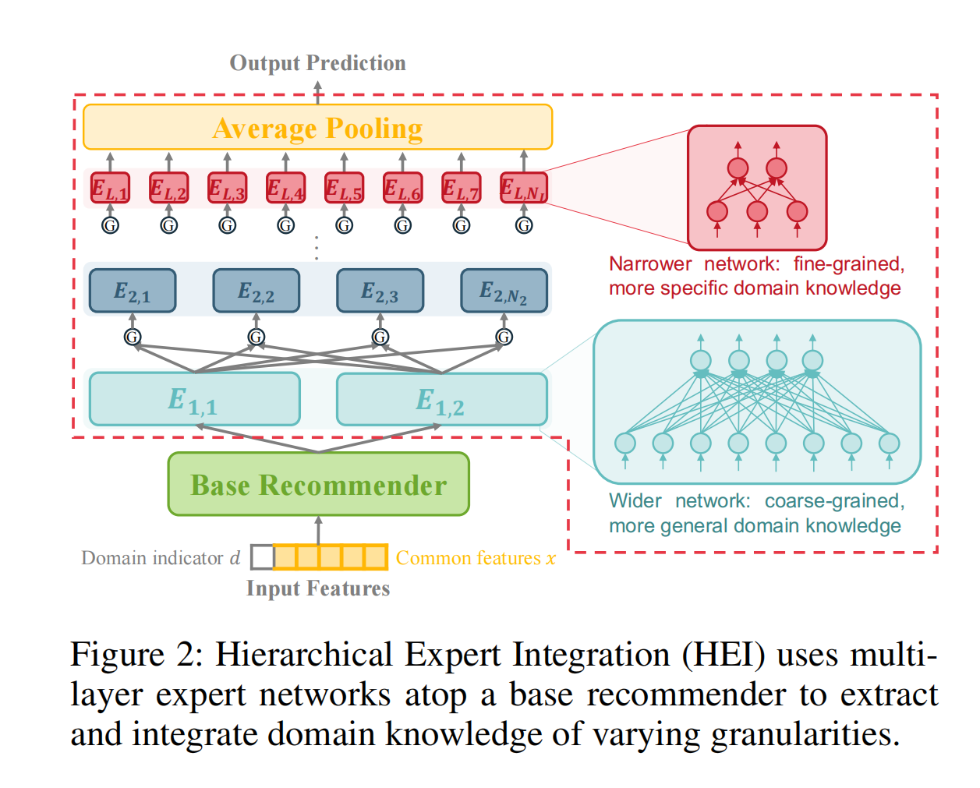
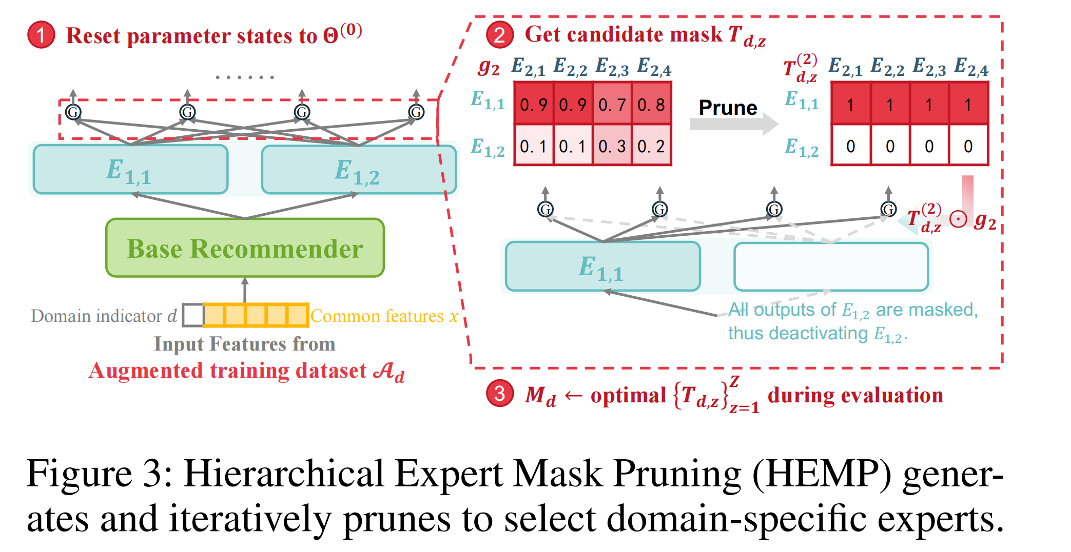
ATAI
ChongqingUniversity _{AdvancedTechniqueof}
of Technology Artificial Intelligence
Chongqing University of
Technology
ATAI
Advanced Technique of Artificial Intelligence
Chongqing University ^{ATAI}
_{of Technology} Advanced Techniqueof
Artificial Intelligence
Chongqing University of Technology
Chongqing University of Technology
Method

Slide 4
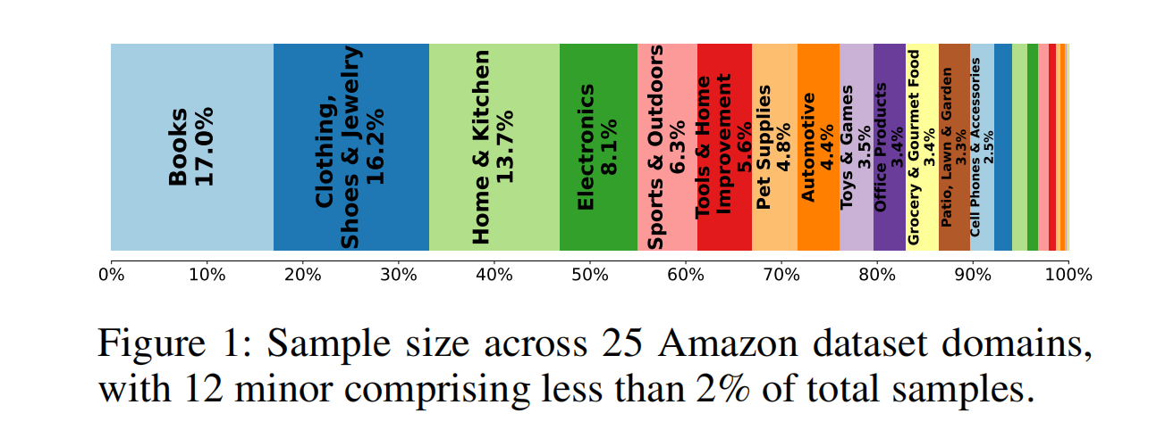
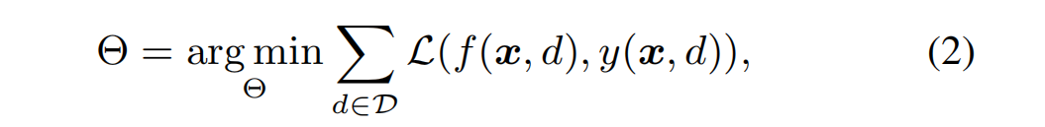
ATAI
Advanced Technique of Artificial Intelligence
ATAI
ChongqingUniversity _{AdvancedTechniqueof}
of Technology Artificial Intelligence
Chongqing University of
Technology
Chongqing University ^{ATAI}
_{of Technology} Advanced Techniqueof
Artificial Intelligence
Chongqing University of Technology
Chongqing University of Technology
Method

Slide 5
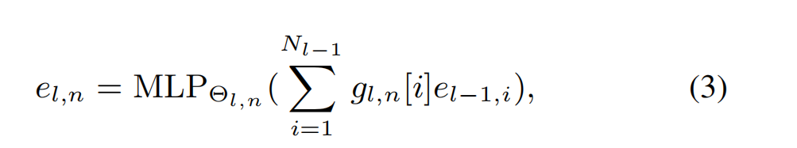
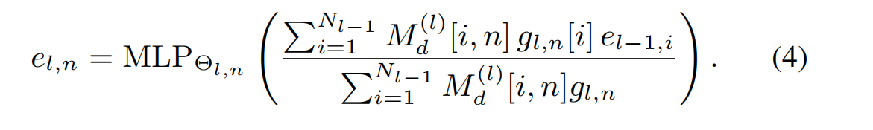
ATAI
Advanced Technique of Artificial Intelligence
ATAI
ChongqingUniversity _{AdvancedTechniqueof}
of Technology Artificial Intelligence
Chongqing University of
Technology
Chongqing University ^{ATAI}
_{of Technology} Advanced Techniqueof
Artificial Intelligence
Chongqing University of Technology
Chongqing University of Technology
Method

Slide 6
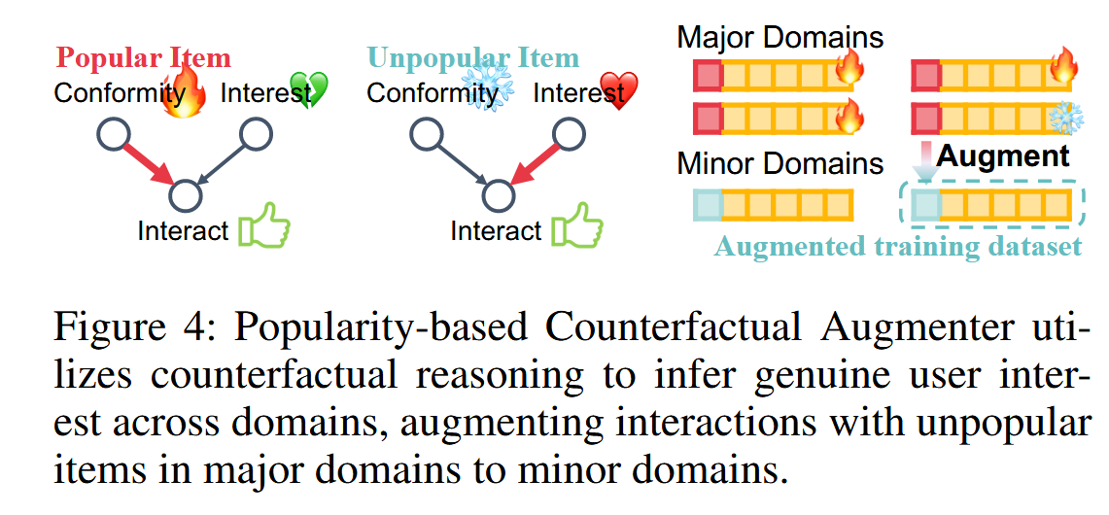
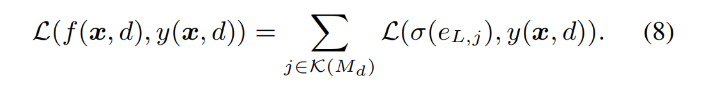
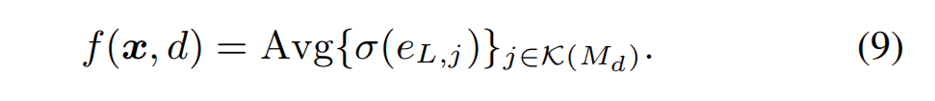
ATAI
Advanced Technique of Artificial Intelligence
ATAI
ChongqingUniversity _{AdvancedTechniqueof}
of Technology Artificial Intelligence
Chongqing University of
Technology
Chongqing University ^{ATAI}
_{of Technology} Advanced Techniqueof
Artificial Intelligence
Chongqing University of Technology
Chongqing University of Technology
Method

Slide 7
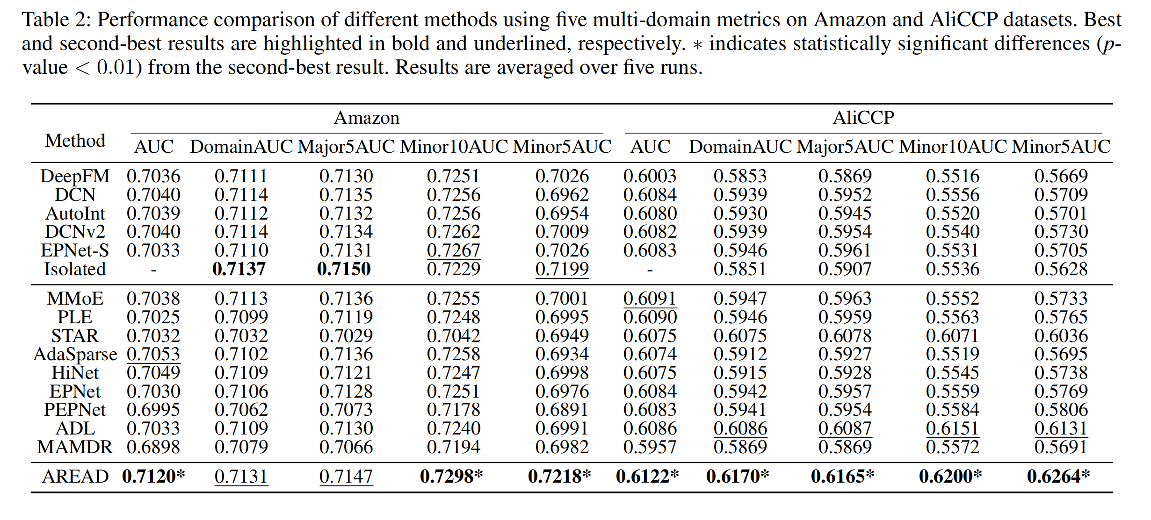
ATAI
Advanced Technique of Artificial Intelligence
ATAI
ChongqingUniversity _{AdvancedTechniqueof}
of Technology Artificial Intelligence
Chongqing University of
Technology
Chongqing University ^{ATAI}
_{of Technology} Advanced Techniqueof
Artificial Intelligence
Chongqing University of Technology
Chongqing University of Technology
Experiments

Slide 8
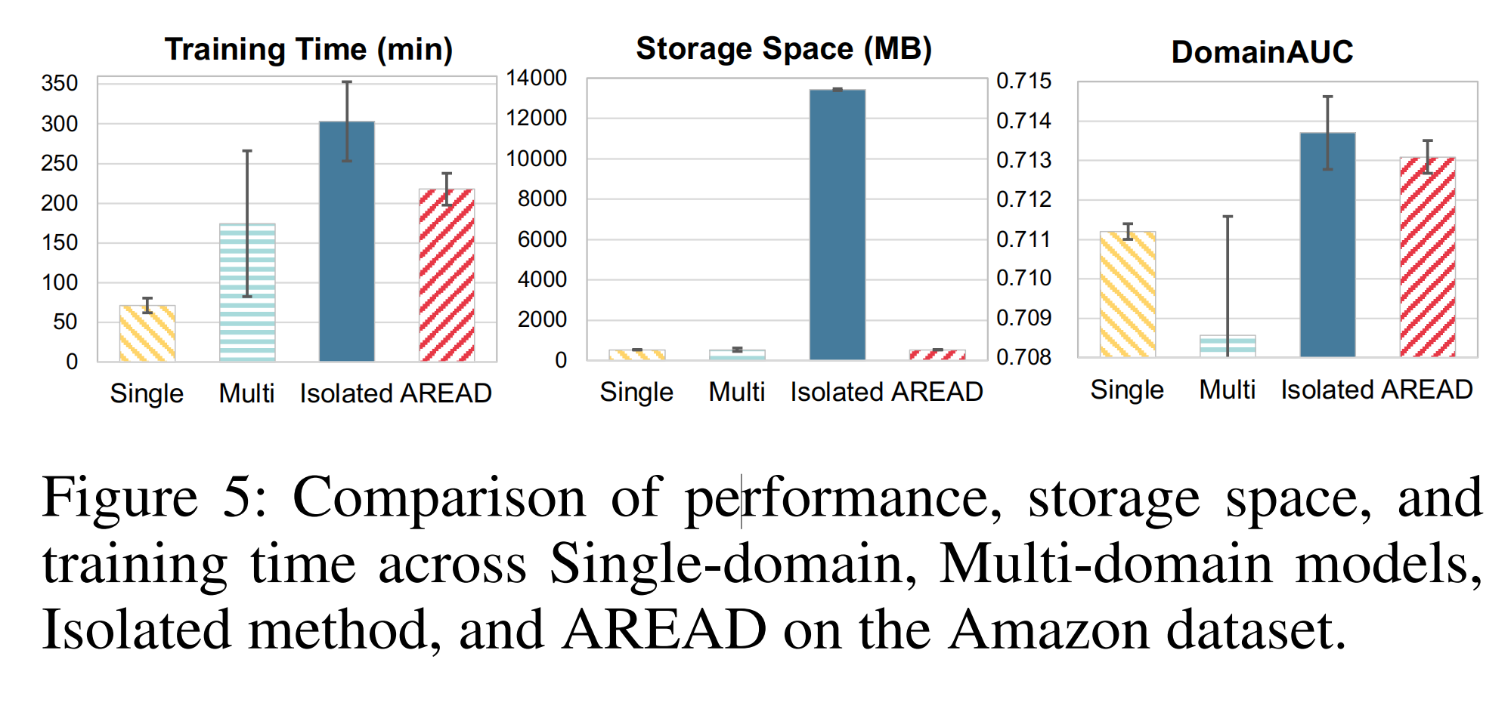
ATAI
Advanced Technique of Artificial Intelligence
ATAI
ChongqingUniversity _{AdvancedTechniqueof}
of Technology Artificial Intelligence
Chongqing University of
Technology
Chongqing University ^{ATAI}
_{of Technology} Advanced Techniqueof
Artificial Intelligence
Chongqing University of Technology
Chongqing University of Technology

Slide 9
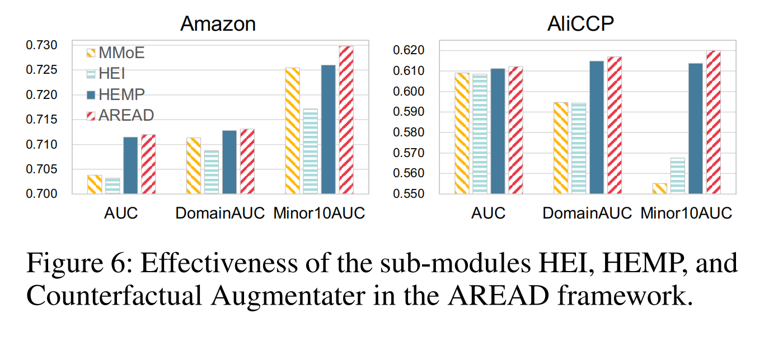
ATAI
Advanced Technique of Artificial Intelligence
ATAI
ChongqingUniversity _{AdvancedTechniqueof}
of Technology Artificial Intelligence
Chongqing University of
Technology
Chongqing University ^{ATAI}
_{of Technology} Advanced Techniqueof
Artificial Intelligence
Chongqing University of Technology
Chongqing University of Technology

Slide 10
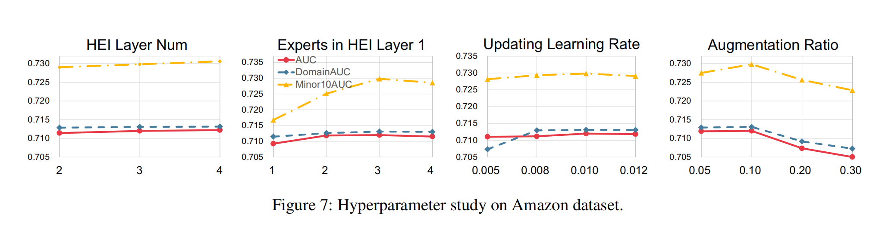
ATAI
Advanced Technique of Artificial Intelligence
ATAI
ChongqingUniversity _{AdvancedTechniqueof}
of Technology Artificial Intelligence
Chongqing University of
Technology
Chongqing University ^{ATAI}
_{of Technology} Advanced Techniqueof
Artificial Intelligence
Chongqing University of Technology
Chongqing University of Technology
Experiments

Slide 11
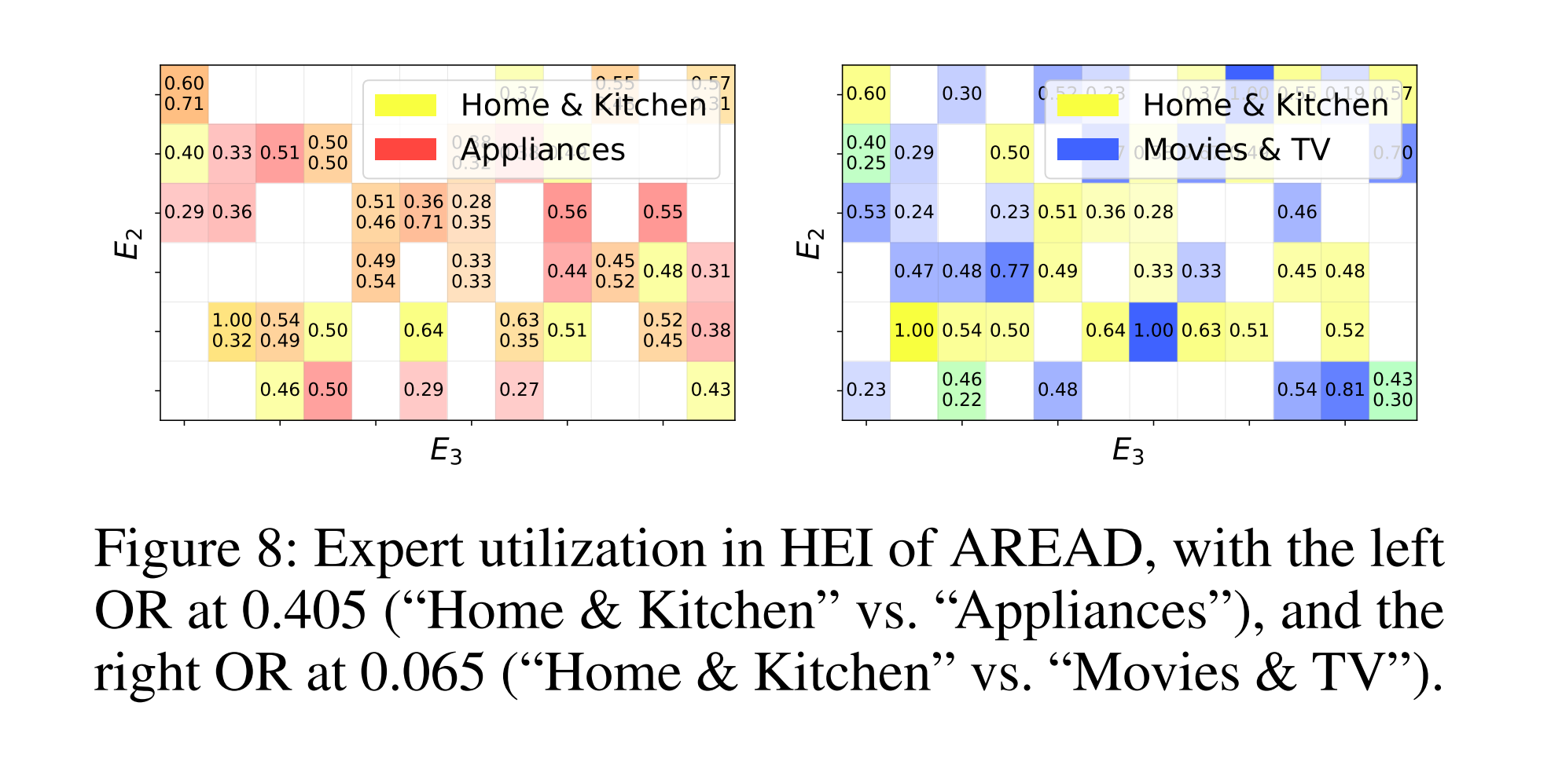
ATAI
Advanced Technique of Artificial Intelligence
ATAI
ChongqingUniversity _{AdvancedTechniqueof}
of Technology Artificial Intelligence
Chongqing University of
Technology
Chongqing University ^{ATAI}
_{of Technology} Advanced Techniqueof
Artificial Intelligence
Chongqing University of Technology
Chongqing University of Technology
Experiments

Slide 12


ATAI
Advanced Technique of Artificial Intelligence
ATAI
ChongqingUniversity _{AdvancedTechniqueof}
of Technology Artificial Intelligence
Chongqing University of
Technology
Chongqing University ^{ATAI}
_{of Technology} Advanced Techniqueof
Artificial Intelligence
Chongqing University of Technology
Chongqing University of Technology
Thanks!

